Slide 1
Legend
H = 1: the 2 distributions are different
H = 0: the 2 distributions are the same
P: significance

Slide 2
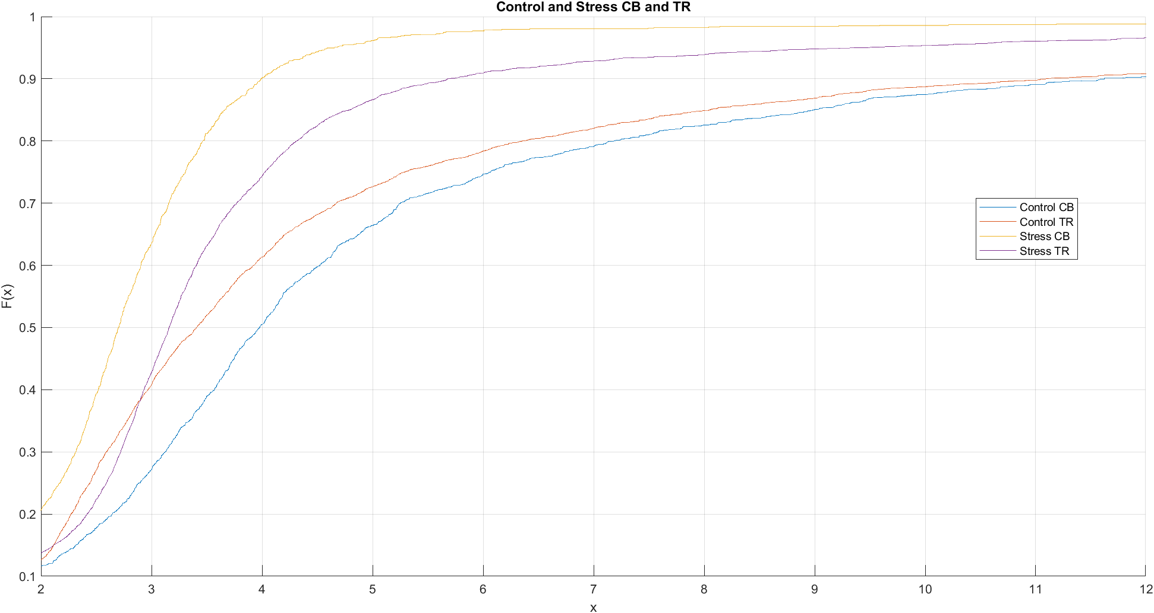
P- Values of ks2test when comparing CB Control to CB Stress, TR Stress, and Tr Control
CB Control compared to TR Control
H=1
P < 0.00005
CB Control Compared to CB Stress
H = 1
P < 0.0005
CB Control Compared to TR Stress
H = 1
P < 0.0005

Slide 3
P- Values of ks2test when comparing TR Control to CB Stress, TR Stress, and CB Control
TR Control compared to CB Control
H=1
P < 0.00005
TR Control Compared to CB Stress
H = 1
P < 0.0005
TR Control Compared to TR Stress
H = 1
P < 0.0005

Slide 4
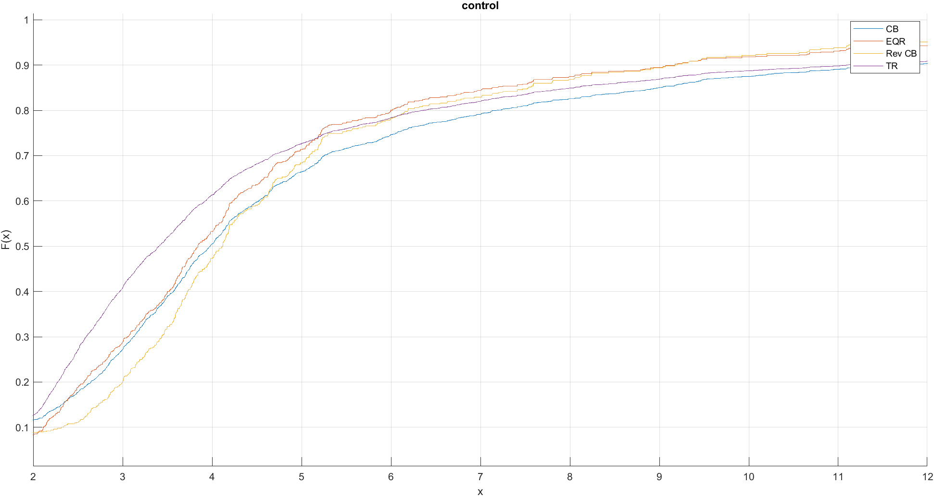
P-values of ks2 when comparing Control CB to Control TR, Control Rev CB, Control EQR
CB Control compared to TR Control
H=1
P < 0.00005
CB Control Compared to EQR Control
H = 1
P < 0.0005
CB Control Compared to Rev CB Control
H = 1
P < 0.0005

Slide 5
P-values of ks2 when comparing Control TR to Control CB, Control Rev CB, Control EQR
TR Control compared to CB Control
H=1
P < 0.00005
TR Control Compared to EQR Control
H = 1
P < 0.0005
TR Control Compared to Rev CB Control
H = 1
P < 0.0005

Slide 6
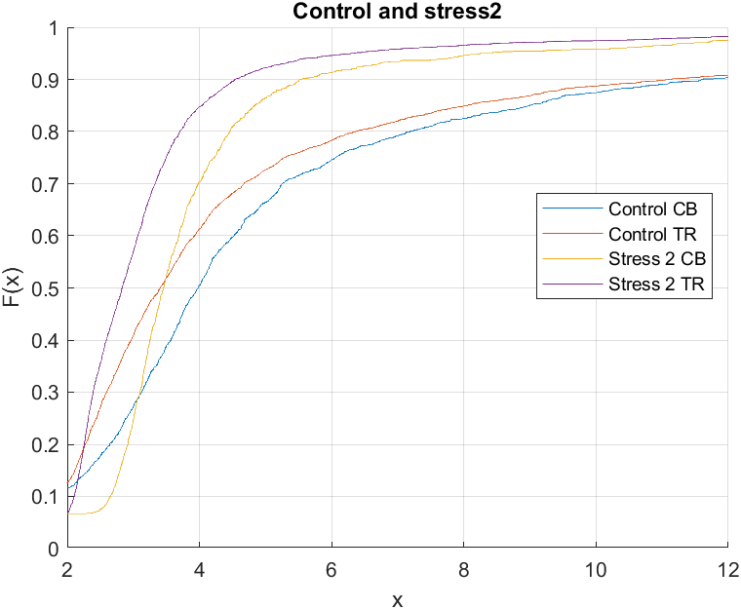
P-values of ks2 when comparing to Control CB to Stress 2 CB and Stress 2 TR
Control CB compared to Stress 2 CB
H = 1
P < 0.0005
Control CB compared to Stress 2 TR
H =1
P < 0.0005

Slide 7
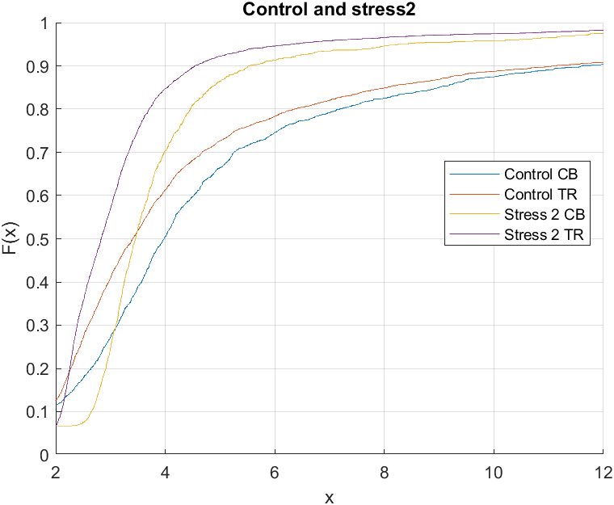
P-values of ks2 when comparing Control TR to Stress2 CB and Stress2 TR
Control TR compared to Stress 2 CB
H = 1
P < 0.0005
Control TR compared to Stress 2 TR
H =1
P < 0.0005

Slide 8
Info On Control Database
Number of Cells in Control: 14785
Number of Rats in Control: 14

Slide 9
Info on stress Database
Number of Cells in stress 1: 12787
Number of Cells in stress 2: 12971
Number of Rats in stress 1: 5
Number of Rats in stress 2: 4

